Slide 1
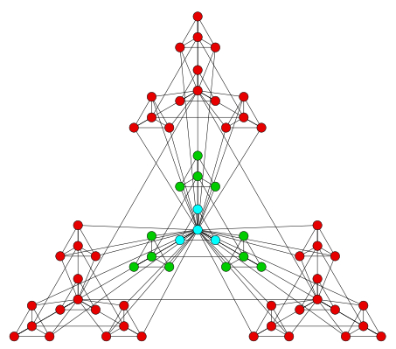


l_{i+1}
r_{i+1}
l_{i}
r_{i}

Slide 3
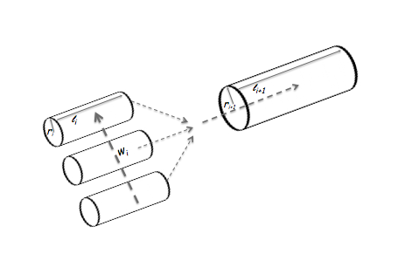
l_{i+1}
r_{i+1}
l_{i}
r_{i}

Slide 4
l
r
w

Slide 5
l_{i+1}
r_{i+1}
l_{i}
r_{i}
w_{i}

Slide 6
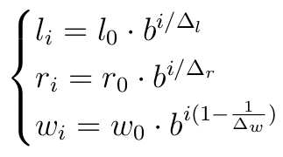
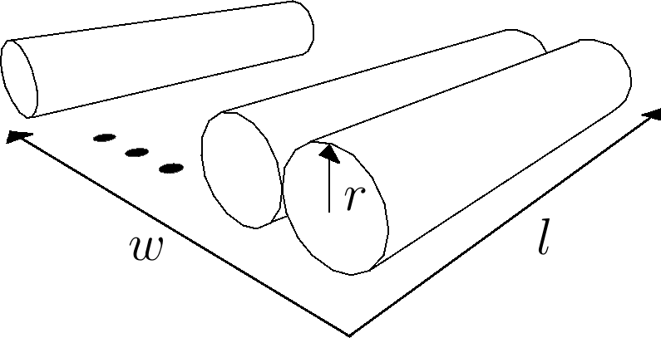
w
d
d
d
d
l
d
d
r
d

